Slide 1

SPCE 5065 VACUUM ENVIRONMENT
Part 1: UV Radiation and Thermal Impacts
UV Solar Degradation
The Thermal Environment
Principles of Heat Transfer
Equilibrium Temperature ranges
Thermal control solutions
Part 2: Contamination & Control
There’s nothing out there. That’s why it’s called space.
John F. Kennedy

Slide 2
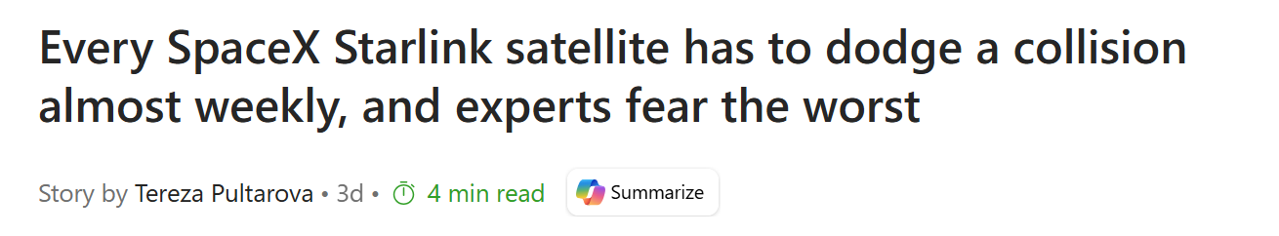
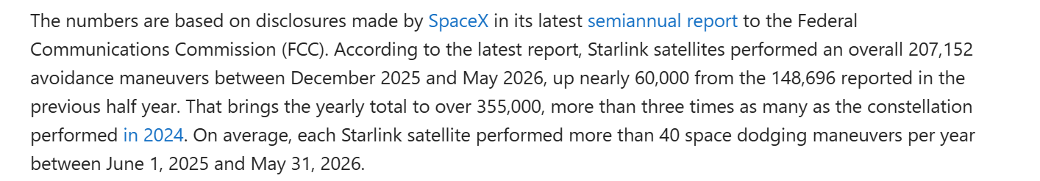
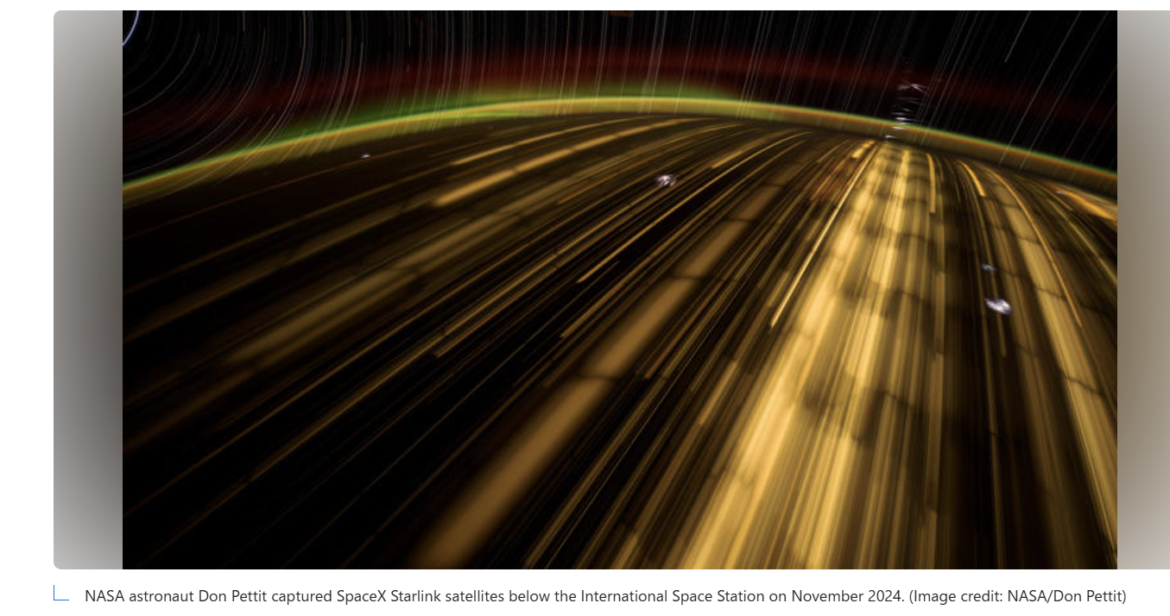

Slide 3
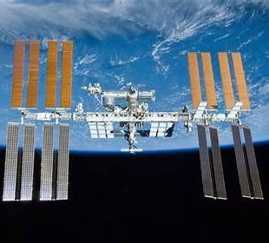

Garrett Kennedy
Homework problem 1 part a
Write:
Summarize the presentation
2) Describe something you learned from it
3) Write one question you have left about the presentation

Slide 4
Jordan Clayton
Homework Problem 1 part b
Write:
Summarize the presentation
2) Describe something you learned from it
3) Write one question you have left about the presentation

Slide 5
Nick Dankel
Homework Problem 1 part c
Write:
Summarize the presentation
2) Describe something you learned from it
3) Write one question you have left about the presentation

Slide 6
Paige Mauldin
Homework Problem 1 part d
Write:
Summarize the presentation
2) Describe something you learned from it
3) Write one question you have left about the presentation

Slide 7
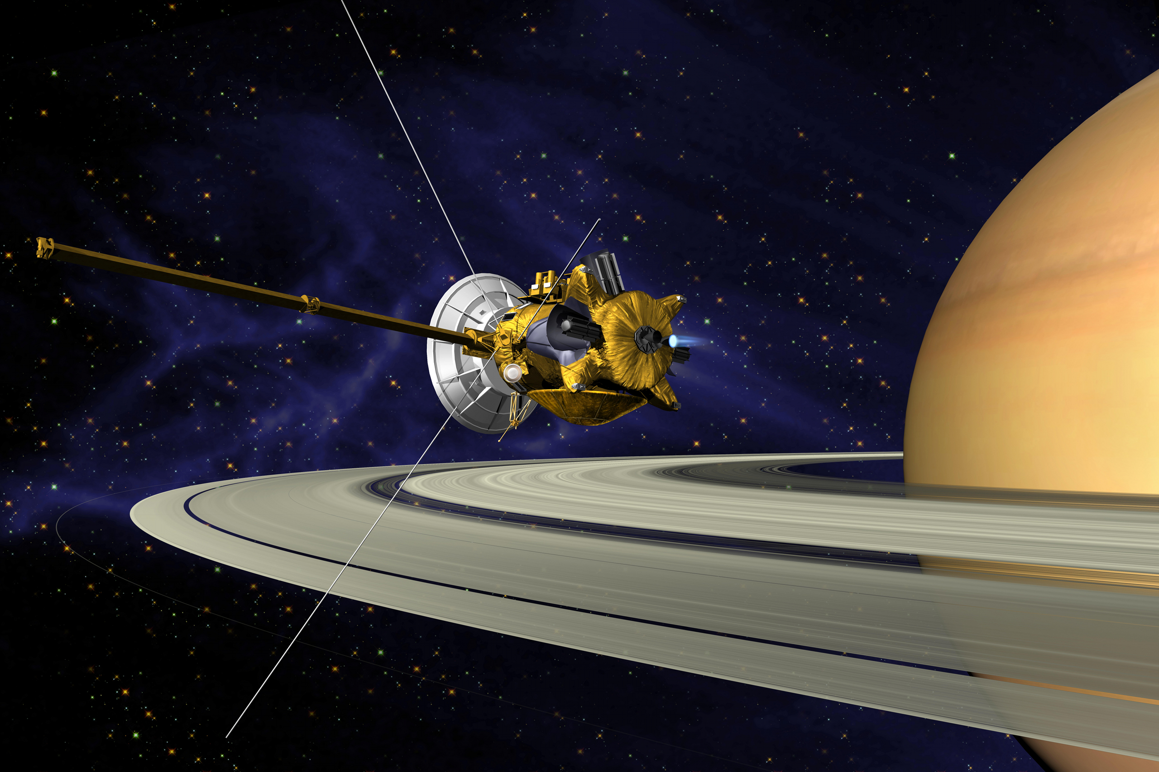
Operating in a Vacuum
BUT … it also causes problems:
Solar ultraviolet degradation
Heat transfer
Self-contamination (outgassing)
Cold welding
Notes:
No convective heat transfer
All radiation with wavelengths less than 0.3 microns is absorbed by the ozone layer, but not so on orbit
Film deposits and no window cleaner

Slide 8
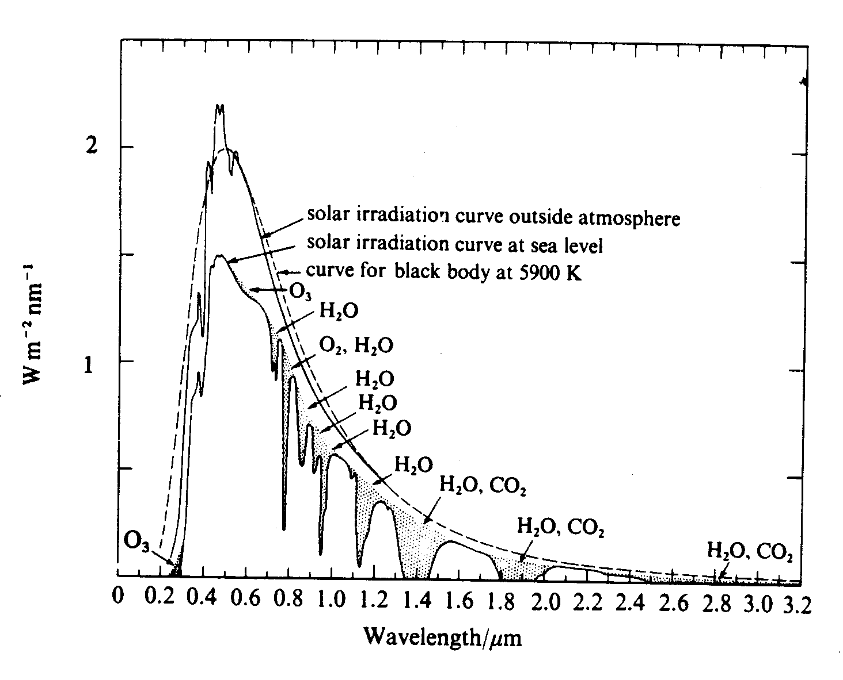
Vacuum Environment: Solar UV Degradation
Reduced protection against solar ultraviolet rays (UV) when compared to the surface of the Earth
W m⁻² nm⁻¹
Wavelength (μm)
Notes:
Darkens visibly during missions because oxygen atoms are removed by ultraviolet exposure
Change in thermal properties can dramatically impact temperatures onboard the spacecraft
Energy of a photon is inversely proportional to wavelength
-- UV @ λ ≤ 0.3 μ m can break many types of organic bonds (UV wavelengths from 0.1 to 3.5 μ m)
⇒ physical characteristics of many materials will change when exposed to UV radiation
Wavelengths shorter than 400 nm

Slide 9
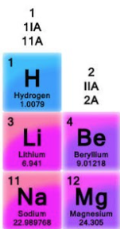
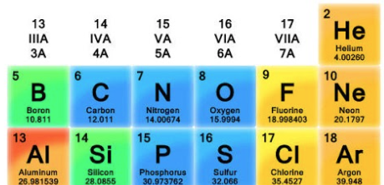


Vacuum Environment: Solar UV Degradation
Some Chemical Bond Energies
Chemical Bond Bond Energy at ${25}^{°}C \left(eV\right)$
C-C Single 3.47
C-N Single 3.17
N-N Single 3.73
O-O Single 1.52
Si-Si Single 2.3
C-C Double 6.29
C-N Double 6.38
C-C Triple 8.59
C-N Triple 9.24
CALCULLA - Table of chemical bond energies
Energy of a single photon (J)
$$E=hf=\frac{hc}{λ}$$
h = Planck’s constant = 6.62607015*10⁻³⁴ J-s
c = speed of light = 3 x 10⁸ m/s
$λ$ = wavelength (m)

Slide 10
EX single Carbon-Carbon Bond

Slide 11
EX single Oxygen-Oxygen Bond

Slide 12
EX Double Carbon-Carbon Bond

Slide 13
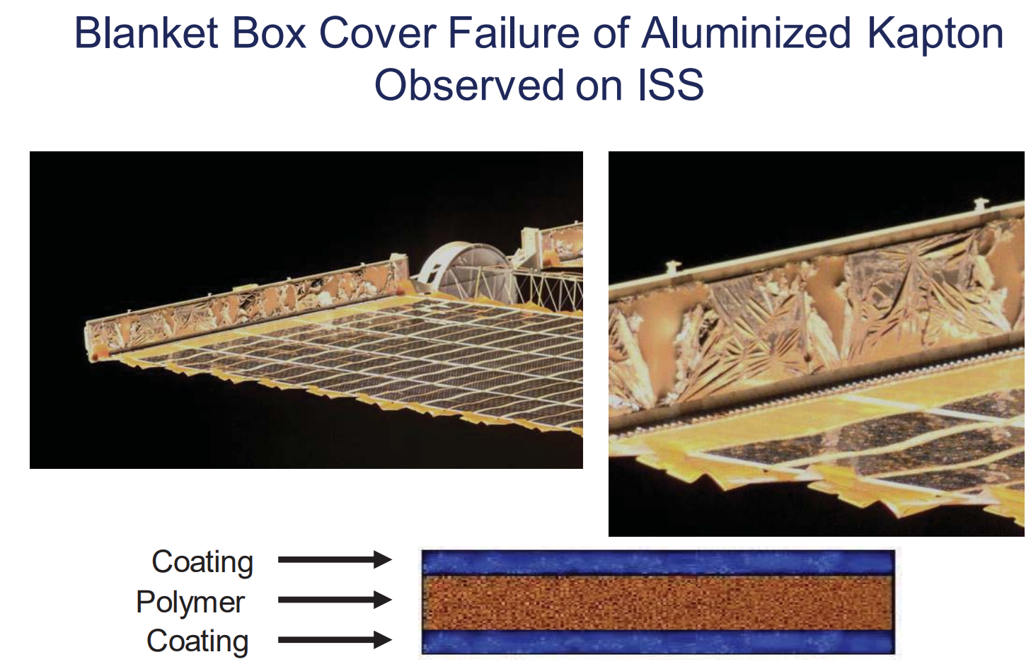

Slide 14
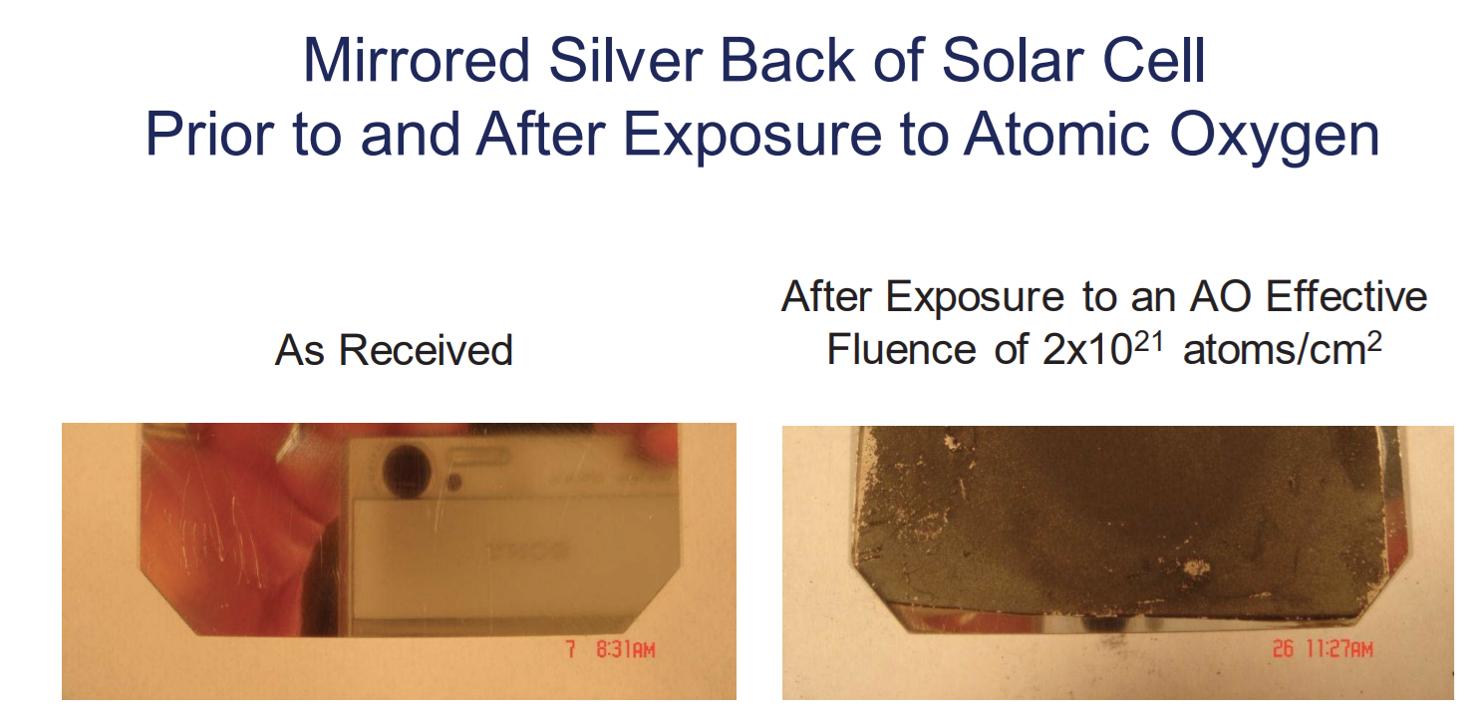

Slide 15
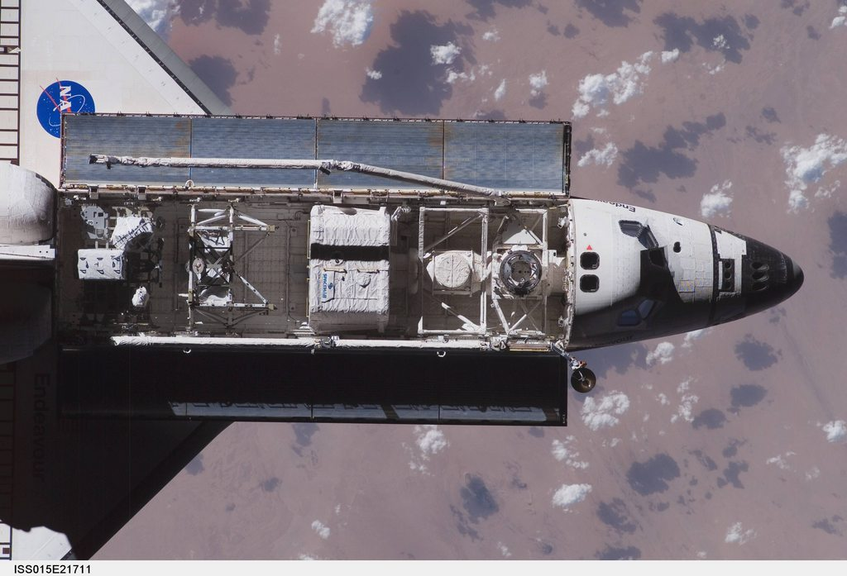
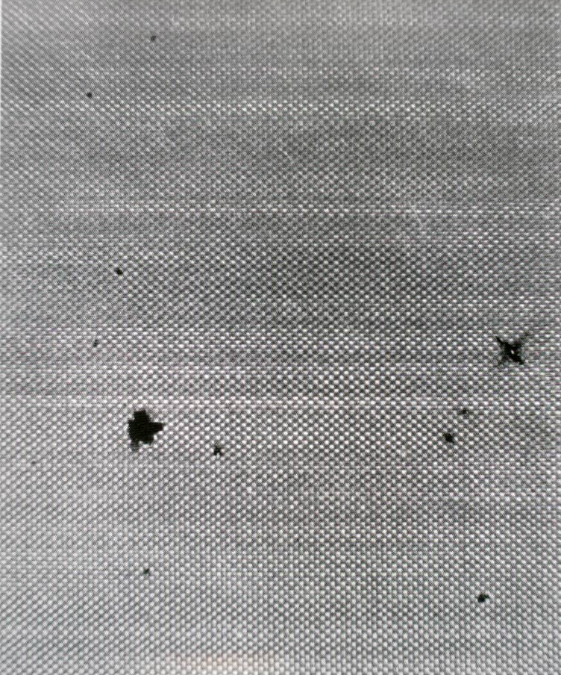
Can degrade surfaces
Betacloth liners in Shuttle payload bay visibly darkened on orbit
Notes:
Darkens visibly during missions because oxygen atoms are removed by ultraviolet exposure
Change in thermal properties can dramatically impact temperatures onboard the spacecraft
Energy of a photon is inversely proportional to wavelength
-- UV @ λ ≤ 0.3 μ m can break many types of organic bonds (UV wavelengths from 0.1 to 3.5 μ m)
⇒ physical characteristics of many materials will change when exposed to UV radiation
Wavelengths shorter than 400 nm

Slide 16

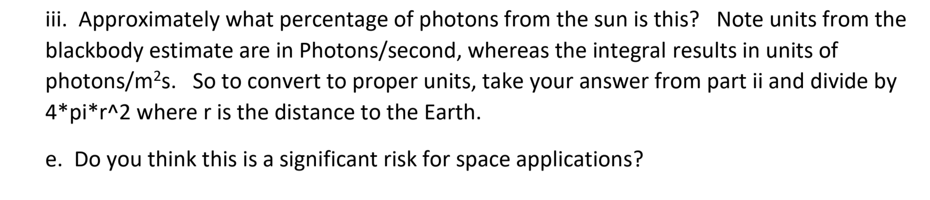
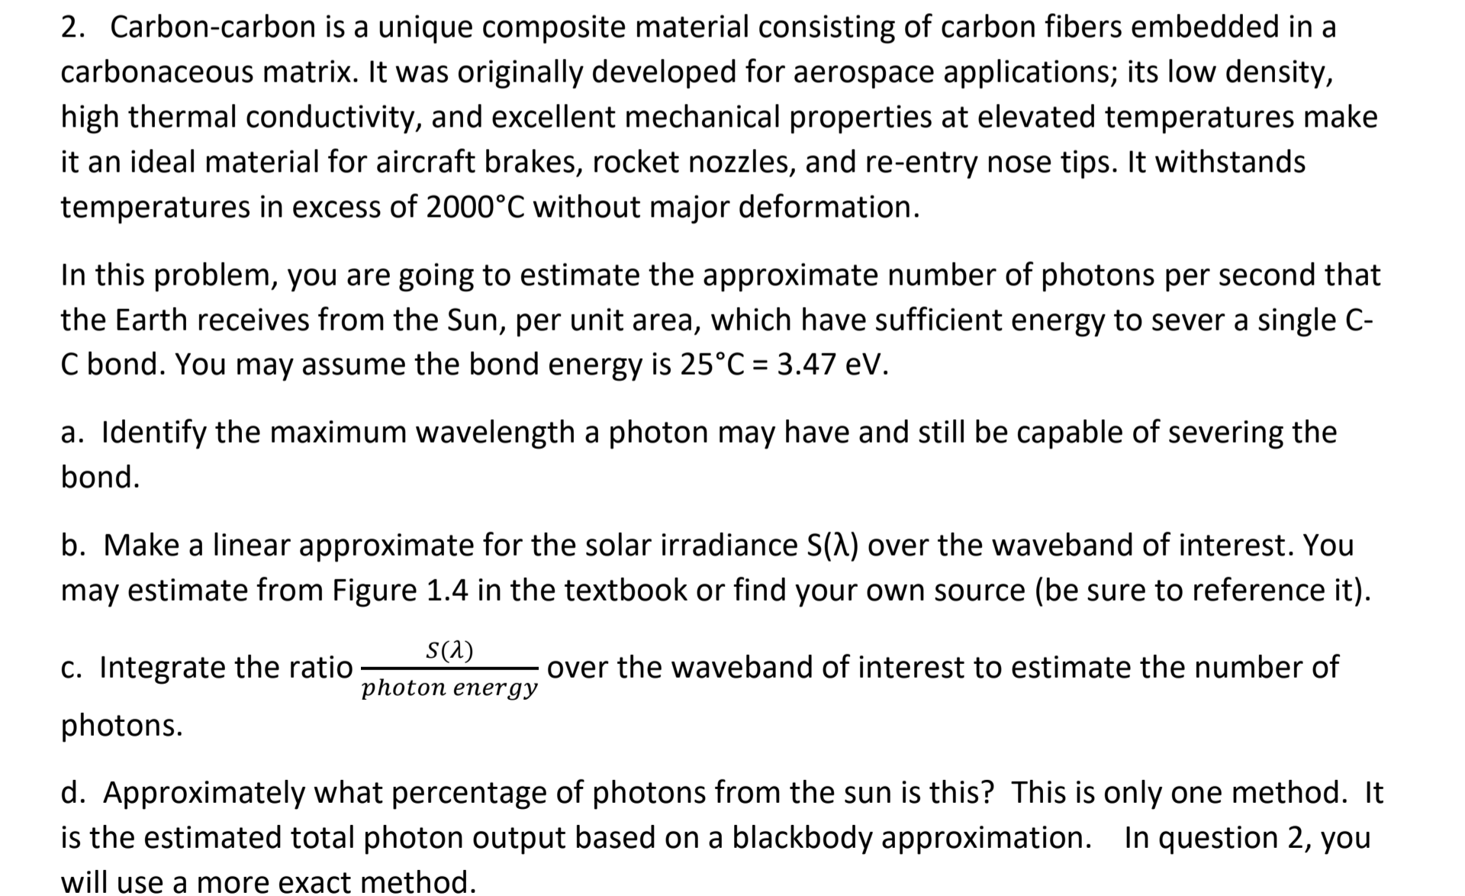
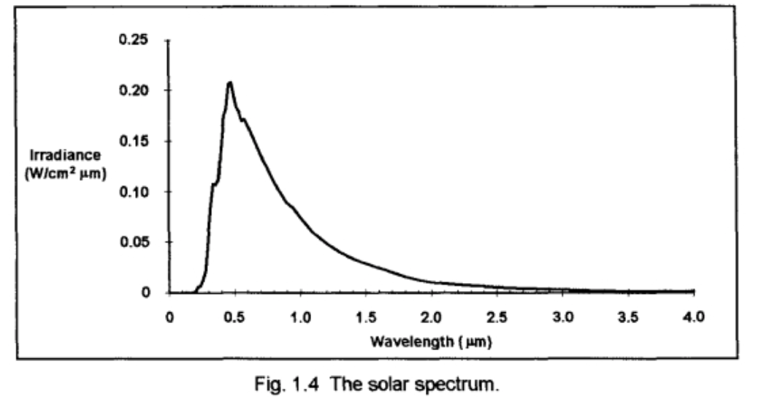
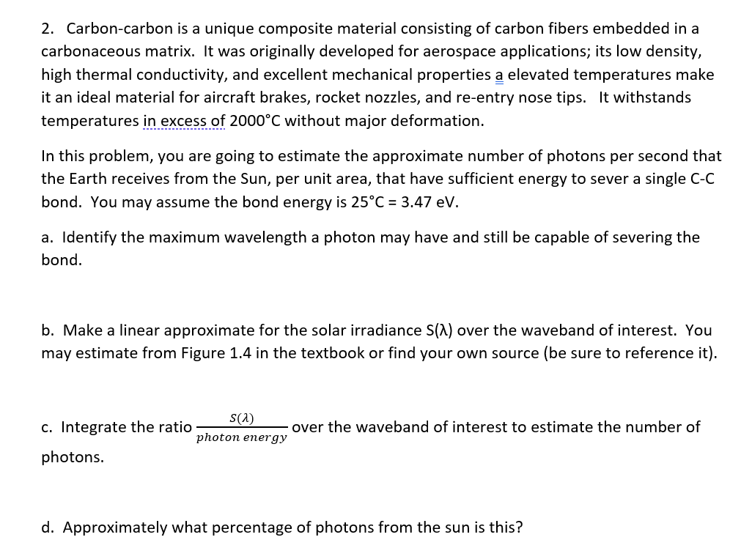
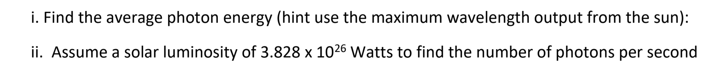

Slide 17
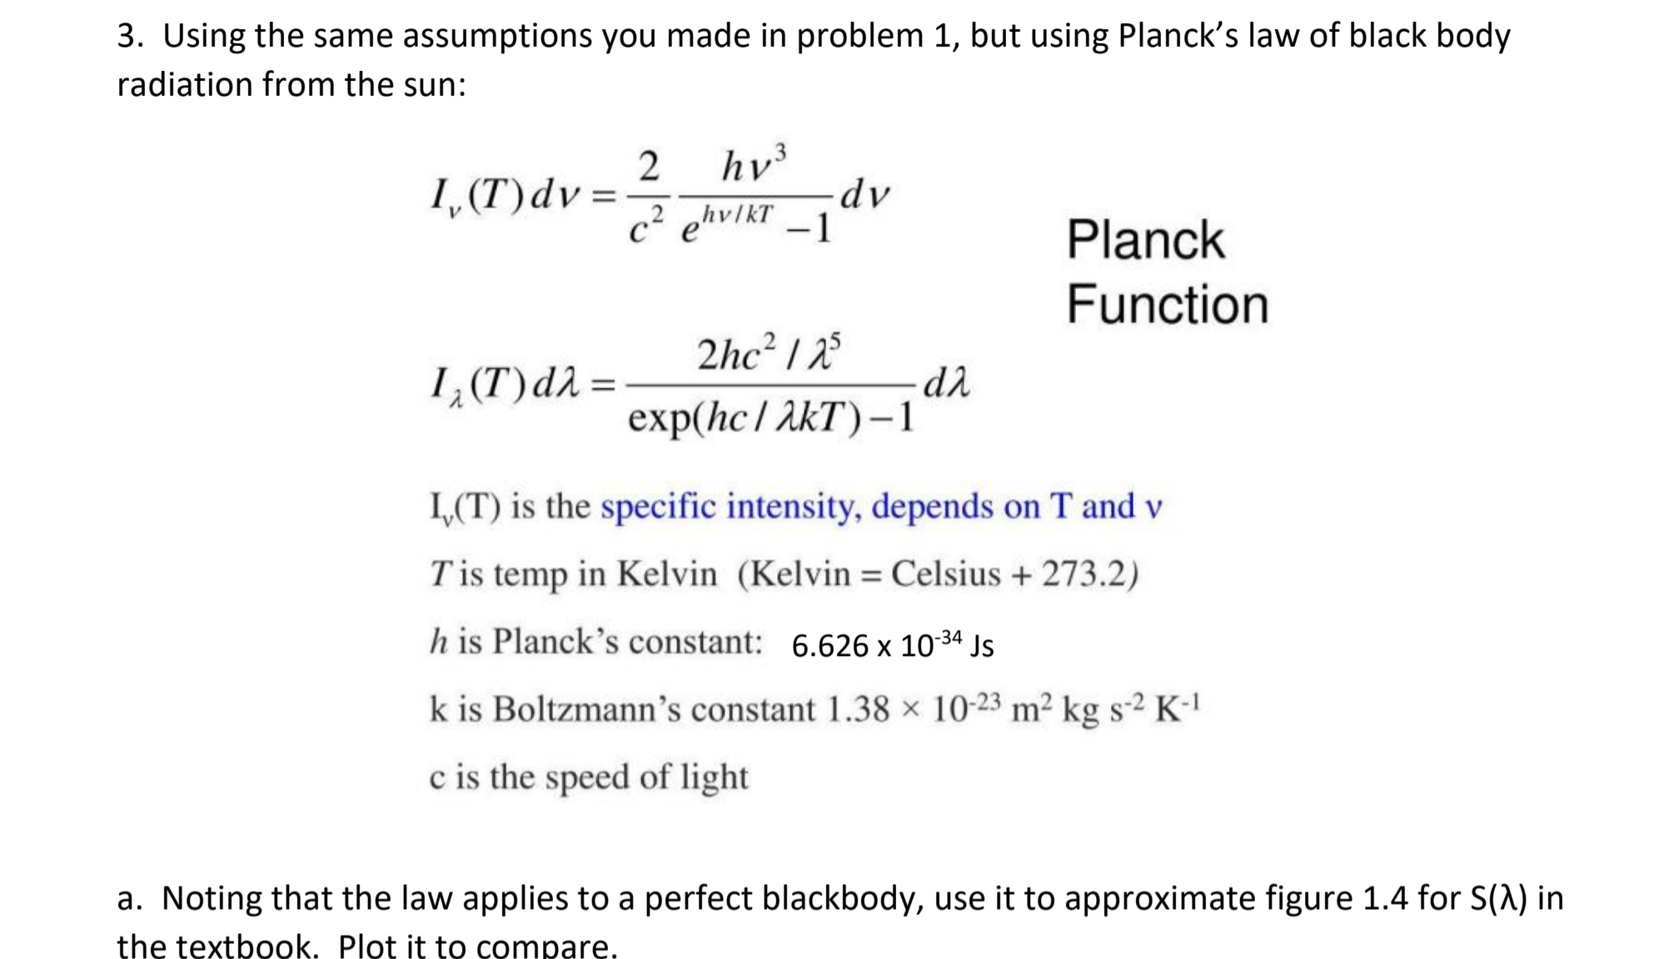
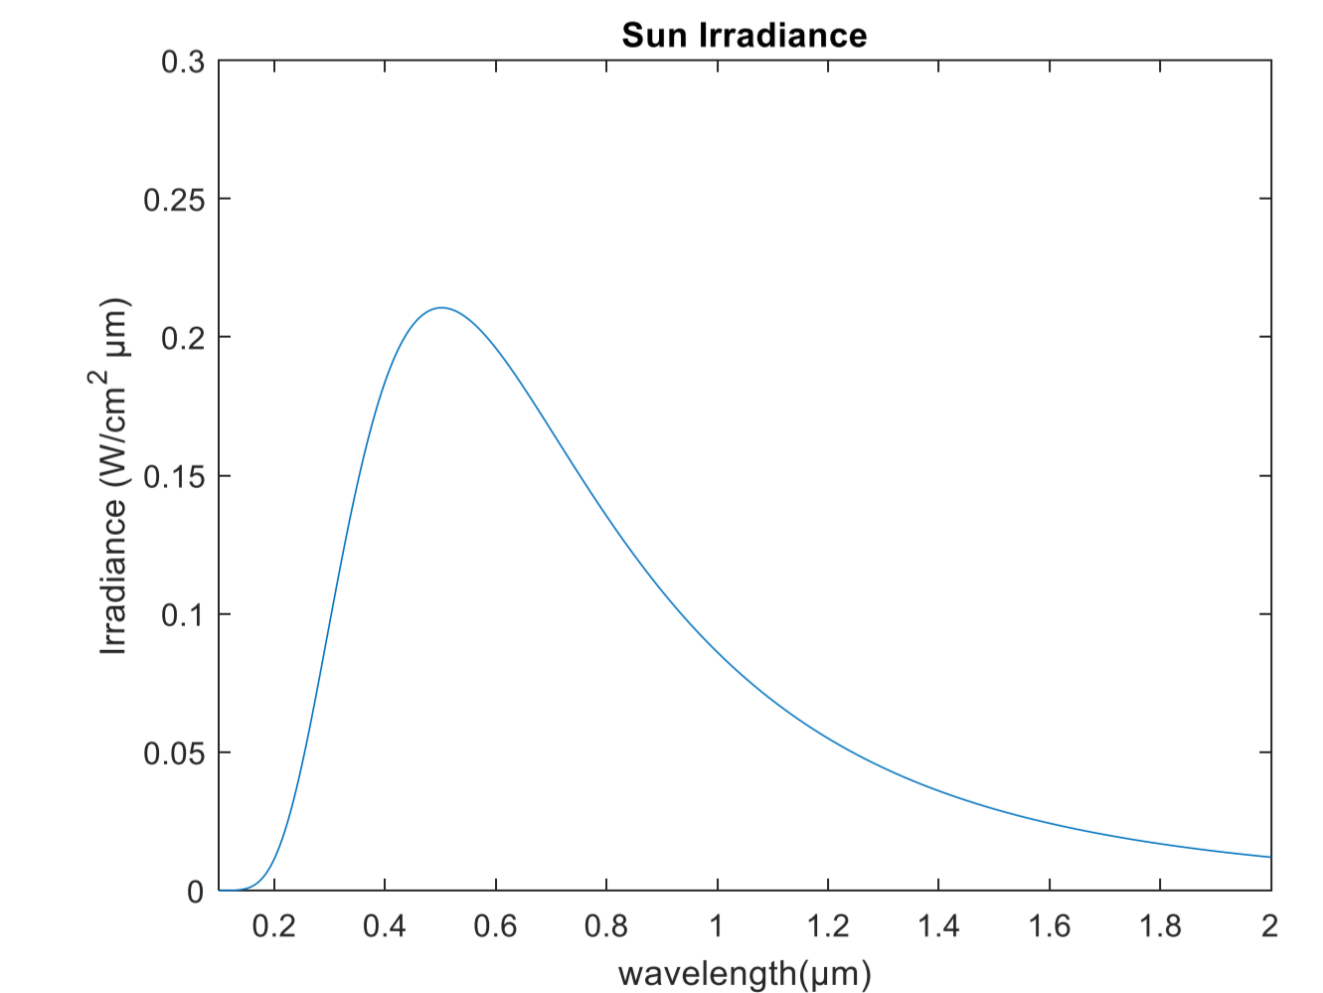
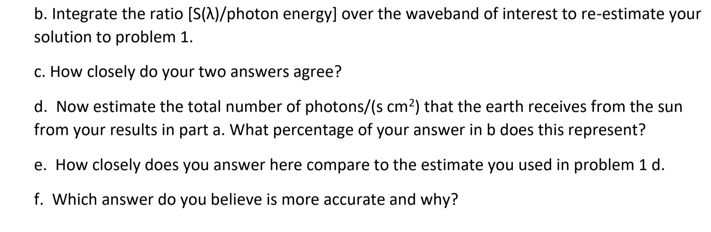

Slide 18
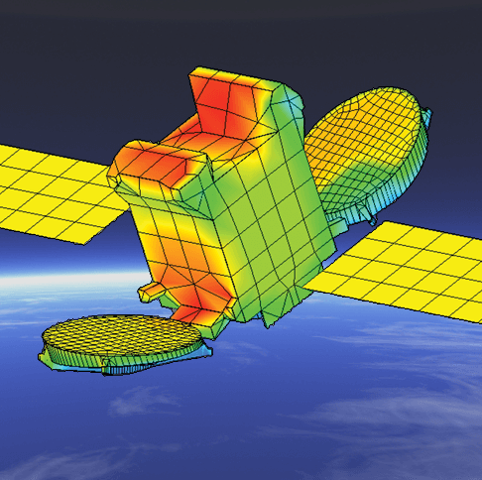
Vacuum Environment: Heat Transfer
Severe thermal cycle because of solar eclipses
Internal power generation increases temperature
Notes:
A lot of energy exists to heat up the spacecraft
Away from spacecraft because there is no atmosphere
Equilibrium temperature
So controlling temperature onboard the spacecraft depends on the thermal characteristics (α /ε ) of the materials used

Slide 19
Vacuum Environment: Heat Transfer
Severe thermal cycle because of solar eclipses
Internal power generation increases temperature
Notes:
A lot of energy exists to heat up the spacecraft
Away from spacecraft because there is no atmosphere
Equilibrium temperature
So controlling temperature onboard the spacecraft depends on the thermal characteristics (α /ε ) of the materials used

Slide 20
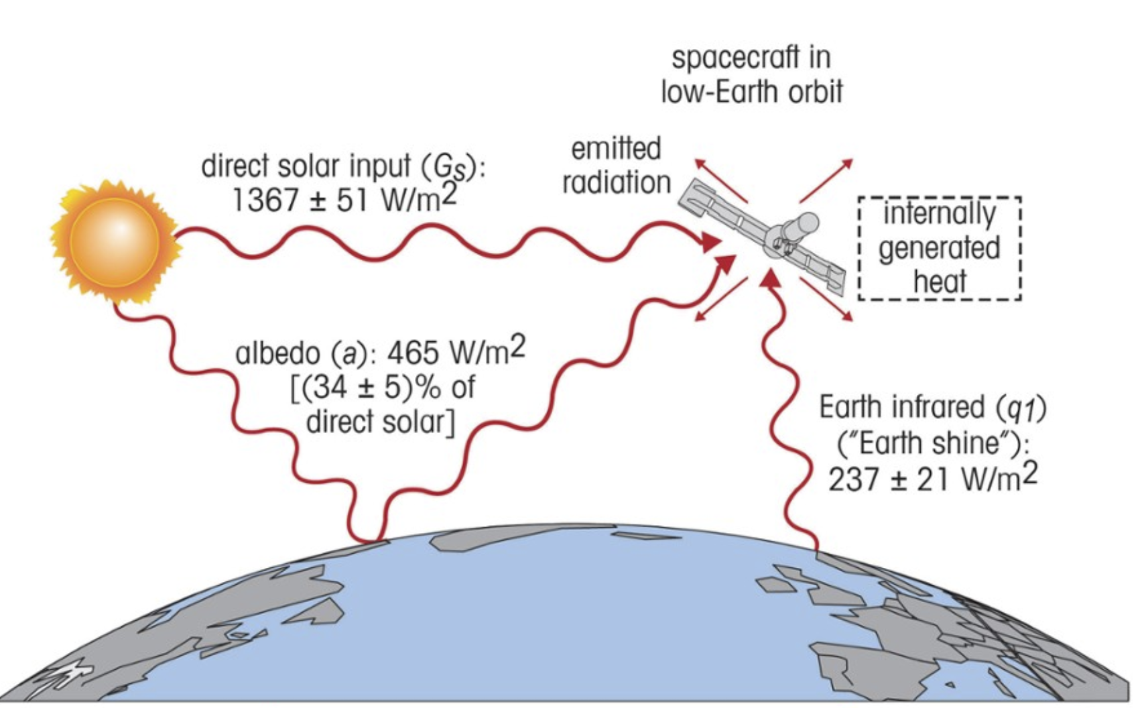
The Thermal Radiation Environment
In equilibrium, energy input = energy output
US, Fig. 13-33
Notes:
Must account for all sources and for the fact that these sources can be highly variable with time
Gone during eclipses
Solar thermal input depends on the distance from the Sun to the spacecraft. At Earth’s orbital radius from the Sun (Earth-orbiting spacecraft) the solar flux is 1367 W/m². At Mars’s orbital radius the solar flux drops to 585 W/m².
Albedo is the solar energy flux that reflects up to the spacecraft from the central body it is orbiting. Albedo from the earth ranges between 425 W/m² and 533 W/m², depending on the reflective surface. Albedo is high off of snow and low off of water and dirt. 465 W/m² is a useful average.
The central body that the satellite orbits also emits energy based on its temperature. Earth emits infrared energy of 237 ± 21 W/m².
Internal energy sources can add up to the total output of the power system, excluding power that is transmitted overboard such as in a communications satellite.

Slide 21
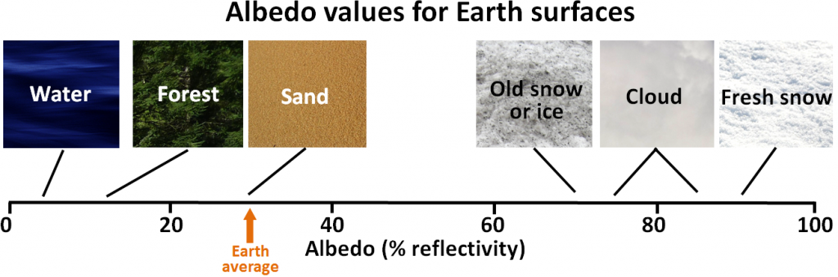

Slide 22
CHALLENGES

Slide 23
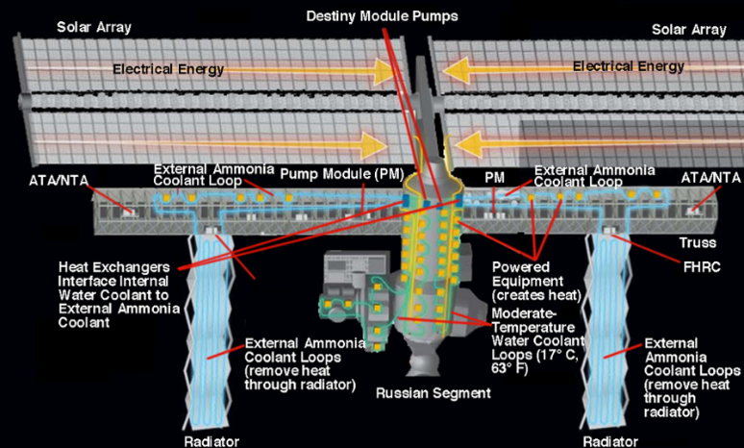
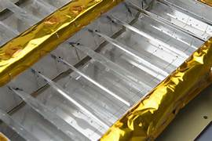
Principles of Heat Transfer
Heat transfer can be separated into three major areas:
Convection – thermal energy transfer between a flowing fluid and a solid surface
Conduction – thermal energy transfer through matter in the absence of fluid motion
Radiation
Operating Temperature range
vs
Survival temperature range
Notes:
Available options to move heat
Generally plays a minor role in unmanned spacecraft (because there is no fluid and zero-g environment)
Can be used to move heat around the spacecraft, but not to eliminate it
All matter radiates electromagnetic energy (the amount depends on temperature).
Severe thermal cycle because of solar eclipses
Internal power generation increases temperature
Figure 13-51 Keeping it Cool on the International Space Station (ISS). The ISS uses the convective cooling of an ammonia coolant that is driven by pumps through the habitation modules, where the coolant absorbs waste heat. The coolant then circulates through radiators, where the heat radiates into space. (Courtesy of NASA)

Slide 24
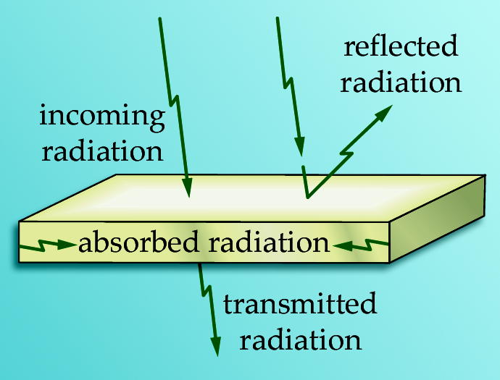

Basics of Thermal Control
Any surface irradiated by electromagnetic radiation either
Transmits it, τ (transmissivity)
Absorbs it, α (absorptivity)
Reflects it, ρ (reflectivity)
τ + ρ + α = 1
US, Fig. 13-37
All matter radiates energy according to the Stefan-Boltzmann equation:
For thermal equilibrium, energy in must equal energy out
$$Q= ε σ A T^{4}$$
absolute temperature
SMAD, Eq 11.11
Heat (W)
surface area
emissivity
Stefan-Boltzmann constant, 5.67 x 10⁻⁸ W m^{–2} K^{–4}
Notes:
Incoming radiation is either ...
Absorptivity (α) is a key material property that defines how much of a problem we will face
A first estimate to determine the required characteristics of the thermal control system can be obtained by evaluating the equilibrium temperature using an energy balance relationship:
HEAT IN = HEAT OUT

Slide 25
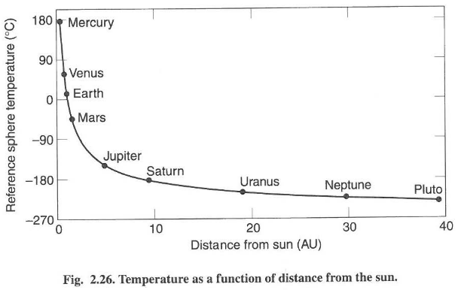

Emissivity and Absorptivity
For a “blackbody”, α = 1 and = 1 (a perfect absorber and emitter)
$$ε$$
Notes:
A representative example
Kirchoff’s Law states:
ε_{λ} = α_{λ}
(but the true value depends on wavelength)
Typical situation:
solar radiation ⇒ use α in the visible range
radiated energy from the spacecraft ⇒ use ε in the IR range

Slide 26

Emissivity and Absorptivity
For real surface coatings, emissivity and absorptivity vary with wavelength:
Solar Wave Band
1.0
White Paint
0.8
ε_{λ}
0.6
IR Wave Band
0.4
0.2
0
2
4
6
8
10
12
14
16
18
20
Siegel & Howell
Thermal Radiation Heat Transfer, Vol I
Lewis Research Center, 1968
Wavelength (microns)
This property allows us to balance thermal loads!
Notes:
A representative example
Kirchoff’s Law states:
ε_{λ} = α_{λ}
(but the true value depends on wavelength)
Typical situation:
solar radiation ⇒ use α in the visible range
radiated energy from the spacecraft ⇒ use ε in the IR range

Slide 27
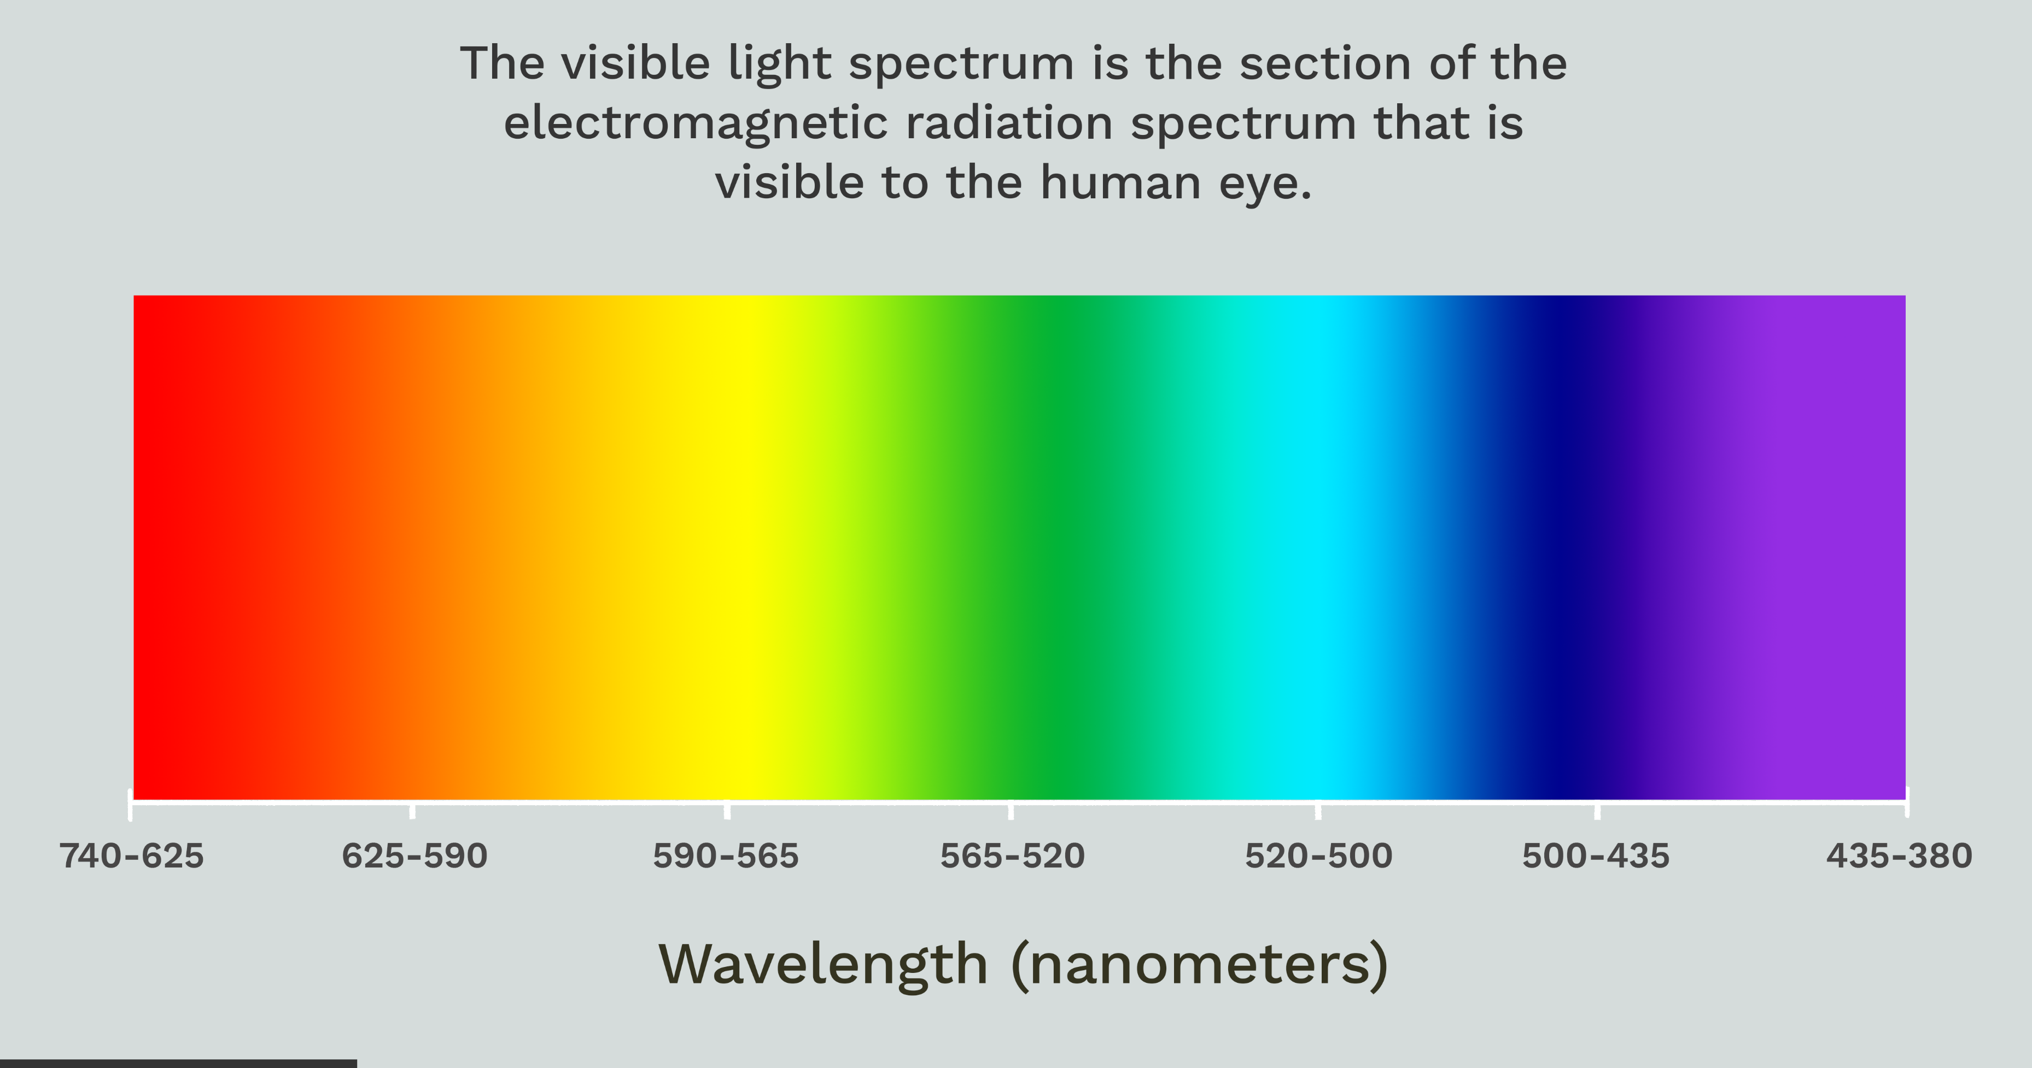

Slide 28
Conservation of Energy and Equilibrium Temperature
Energy must be conserved:
SMAD, Eq 11.12
SMAD, Eq 11.14
For a satellite in Earth orbit, externals sources of heat include direct sunlight, sunlight reflected off of the Earth, and Earth IR radiated energy
Using this energy balance relationship, we can determine the equilibrium temperature and, if necessary, change how the satellite radiates heat
Notes:
Here are the details of the energy balance relationship
Design parameters

Slide 29
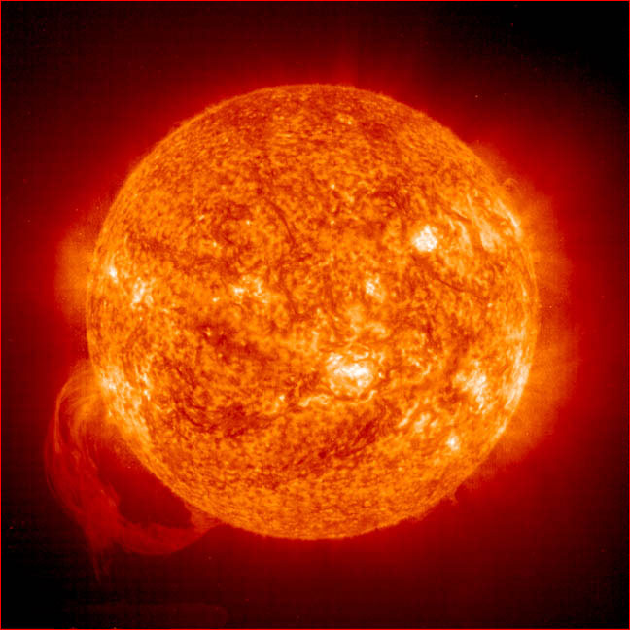


Conservation of Energy and Equilibrium Temperature
Solar flux = 1367 watts/m² for earth
Notes:
If you don’t know where to start for emissivity and absorptivity, start with these as estimates.

Slide 30

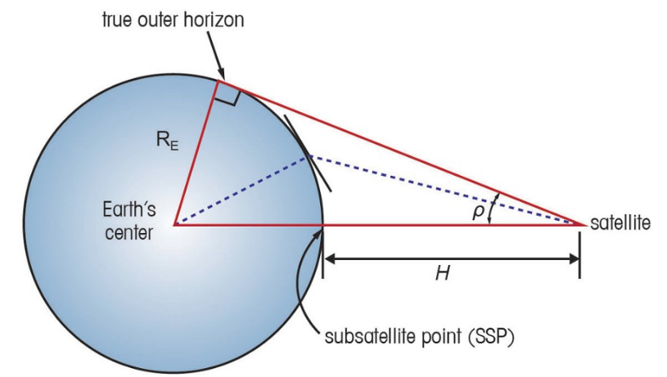




Conservation of Energy and Equilibrium Temperature
Albedo Flux $≈465$ $\frac{W}{m^{2}} for earth$
$$Q_{IR}=αA\sin^{2}\left(ρ\right)IRflux$$
IR Flux $≈237$ $\frac{W}{m^{2}} for earth$

Slide 31
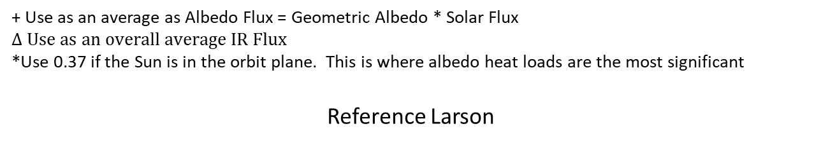
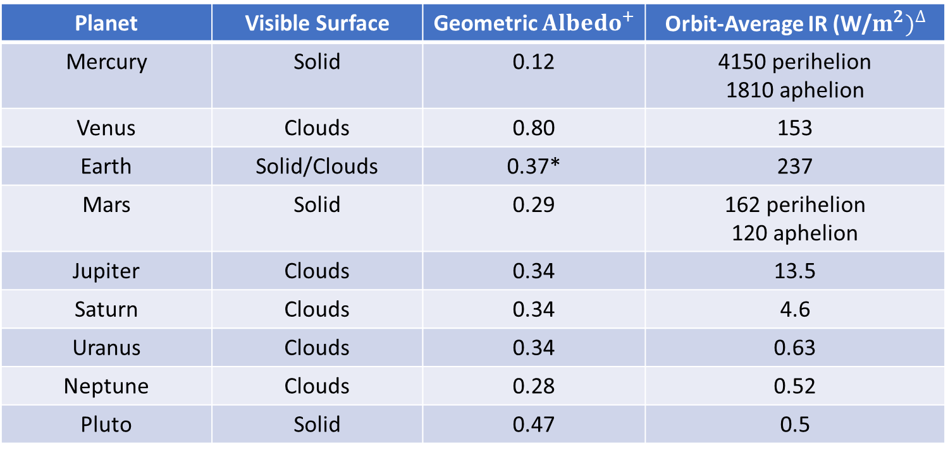
AVERAGE ALBEDOS AND IR EMISSIONS OF THE PLANETS
Planet | Visible Surface | Geometric ${Albedo}^{+}$ | Orbit-Average IR (W/$m^{2})^{∆}$
Mercury | Solid | 0.12 | 4150 perihelion 1810 aphelion
Venus | Clouds | 0.80 | 153
Earth | Solid/Clouds | 0.37* | 237
Mars | Solid | 0.29 | 162 perihelion 120 aphelion
Jupiter | Clouds | 0.34 | 13.5
Saturn | Clouds | 0.34 | 4.6
Uranus | Clouds | 0.34 | 0.63
Neptune | Clouds | 0.28 | 0.52
Pluto | Solid | 0.47 | 0.5
+ Use as an average as Albedo Flux = Geometric Albedo * Solar Flux
$$∆ Use as an overall average IR Flux$$
*Use 0.37 if the Sun is in the orbit plane. This is where albedo heat loads are the most significant
Reference Larson

Slide 32
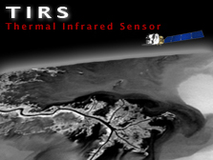
Vacuum Environment: Solar UV Degradation
May significantly alter α/ε ratios, depending on the tolerance of the material to UV radiation, resulting in significant temperature changes
Notes:
Darkens visibly during missions because oxygen atoms are removed by ultraviolet exposure
Change in thermal properties can dramatically impact temperatures onboard the spacecraft
Energy of a photon is inversely proportional to wavelength
-- UV @ λ ≤ 0.3 μ m can break many types of organic bonds (UV wavelengths from 0.1 to 3.5 μ m)
⇒ physical characteristics of many materials will change when exposed to UV radiation
The Thermal Infrared Sensor (TIRS) was added to the Landsat 8 payload to continue thermal imaging and to support emerging applications such as evapotranspiration rate measurements for water management. TIRS was built by NASA Goddard Space Flight Center, and it has a three-year design life. The 100 m TIRS data is registered to the OLI data to create radiometrically, geometrically, and terrain-corrected 12-bit Landsat 8 data product.

Slide 33
Isothermal Spacecraft Example
Identify the steady-state temperatures (in the eclipse and in the sun) for a 1𝑚³ cube isothermal spacecraft. It is in an orbit at an altitude of 1000 km and an inclination of 0˚. The satellite internal components generate 500W of heat at all times during its 5 year mission life. Assume body mounted solar panels on four sides of the satellite. Identify its steady-state temperatures during sunlight and eclipse periods. Assume the solar arrays have an absorptivity (α) = .975 and emissivity = .85. All spacecraft components must be kept between 0 °C to 35 °C.
Assumptions:
- Only one side of spacecraft is illuminated by the sun at a time with a sun incidence angle of 0°
- Only one side of spacecraft is facing the earth at a time with a sun incidence angle of 0°
- Remaining 2 panels are covered with insulation, so heat is essentially neither absorbed nor emitted

Slide 34
Isothermal Spacecraft Example
Identify the steady-state temperatures (in the eclipse and in the sun) for a 1𝑚³ cube isothermal spacecraft. It is in an orbit at an altitude of 1000 km and an inclination of 0˚. The satellite internal components generate 500W of heat at all times during its 5 year mission life. Assume body mounted solar panels on four sides of the satellite. Identify its steady-state temperatures during sunlight and eclipse periods. Assume the solar arrays have an absorptivity (α) = .975 and emissivity = .85. All spacecraft components must be kept between 0 °C to 35 °C.
Assumptions:
- Only one side of spacecraft is illuminated by the sun at a time with a sun incidence angle of 0°
- Only one side of spacecraft is facing the earth at a time with a sun incidence angle of 0°
- Remaining 2 panels are covered with insulation, so heat is essentially neither absorbed nor emitted

Slide 35
Isothermal Spacecraft Example
Identify the steady-state temperatures (in the eclipse and in the sun) for a 1𝑚³ cube isothermal spacecraft. It is in an orbit at an altitude of 1000 km and an inclination of 0˚. The satellite internal components generate 500W of heat at all times during its 5 year mission life. Assume body mounted solar panels on four sides of the satellite. Identify its steady-state temperatures during sunlight and eclipse periods. Assume the solar arrays have an absorptivity (α) = .975 and emissivity = .85. All spacecraft components must be kept between 0 °C to 35 °C.
Assumptions:
- Only one side of spacecraft is illuminated by the sun at a time with a sun incidence angle of 0°
- Only one side of spacecraft is facing the earth at a time with a sun incidence angle of 0°
- Remaining 2 panels are covered with insulation, so heat is essentially neither absorbed nor emitted

Slide 36
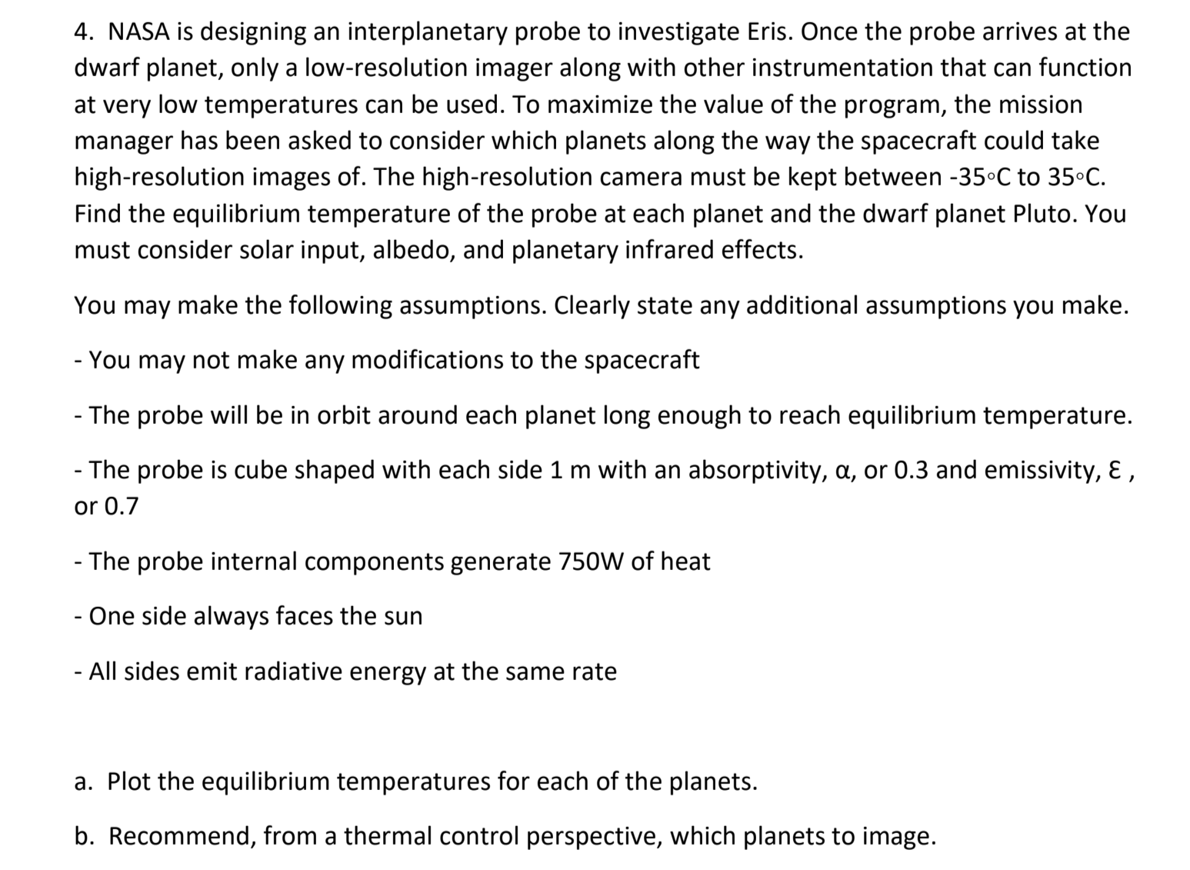
HOMEWORK 6 PROBLEM 4

Slide 37
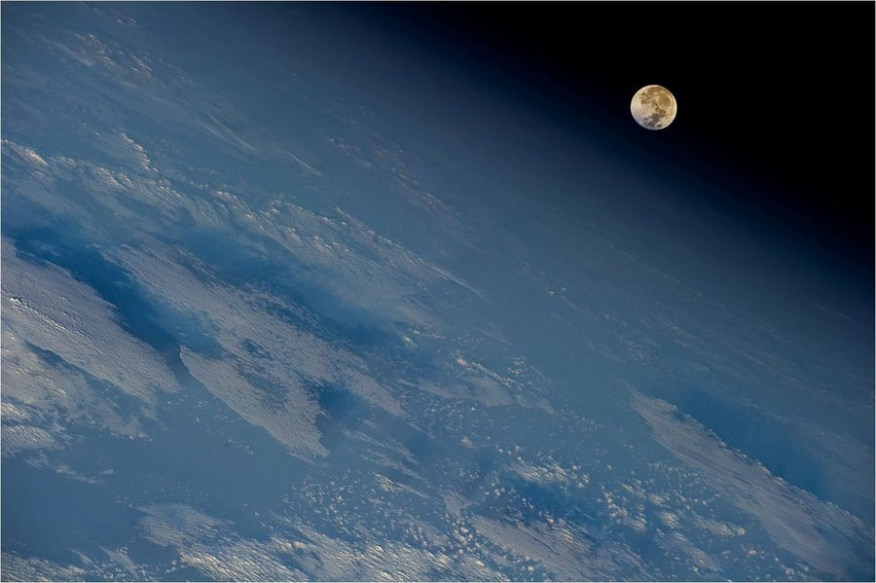
THERMAL CONTROL SOLUTIONS
Thermal Control Systems

Slide 38
Components of a Thermal Control System
Passive elements:
Component | Comments
Materials and coatings | Surfaces and materials with special radiation or thermo-optical properties that provide the desired thermal performance Examples: white and black paints, silver-coated teflon, polished metals, second-surface mirrors
Multilayer insulation (MLI) | Multiple layers of low-emittance films with low conductivity between layers (e.g., thin mylar sheets with a vacuum-deposited aluminum finish on one side of each sheet)
Radiators | Heat exchange devices located on the outer surfaces of a spacecraft designed to reject heat by IR radiation
Cold plates | Mounted on heat dissipating equipment to transfer heat away from the equipment via conduction
Phase change devices | Absorb thermal energy using a solid-to-liquid phase change Helpful for electrical equipment with high, short bursts of power
Heat pipes | Hermetically sealed tube with a wicking device on the inside surface. Fluid inside the tube changes phase and capillary forces draw the fluid from the condenser end to the evaporator end of the pipe to transfer heat Types include constant-conductance, one-way (diode), and variable-conductance heat pipes
Typically, passive techniques take care of approximately 80% of all thermal control activities
Notes:
Surfaces with special radiation properties:
-- paints
-- mirrors
-- silverized plastics
-- Mylar or Kapton insulation
Used to absorb high, short bursts of energy
Move heat around

Slide 39
Components of a Thermal Control System
Active elements:
Notes:
Modulates radiator behavior

Slide 40
Preliminary Thermal Design Process
Step | Inputs | Outputs | Key Issues
1. Identify thermal requirements and constraints | Component thermal requirements | System level thermal reqmts Specialized requirements for specific equipment | Identify payload thermal requirements Identify major elements that may present thermal challenges (see Step 3)
2. Determine thermal environment | Orbit/attitude history S/C size & shape Internal heat sources | Total energy input to the s/c Profile of energy input vs. time | Max & min distances to Sun Max & min distances to Earth or other central body Chemical or nuclear internal heat sources
3. Identify thermal challenges or problem areas | Thermal requirements Heat sources Equipment placement and attitude history | List of specific thermal problem areas or problem times or events (hot, cold, or stability | Identify major elements that Generate large amounts of heat Need cryo operating temperatures Have boiling or freezing problems Require a narrow temperature range Identify extraordinary thermal events or actions
4. Identify applicable thermal control techniques | Thermal requirements and energy profile (from above) Additional constraints | Preliminary list of thermal control mechanisms for mission duration and principal spacecraft components, areas, or times | Prefer passive over active means Component placement often key Pay particular attention to problem areas or sever thermal constraints Watch for mission critical issues (freezing propellant or hinge; fluid boiling or potential explosions)
5. Determine radiator and heater requirements | List of thermal environments & events Thermal control approach Component temp reqmts | Radiator sizes and temps to manage hot case with margin Heater power for cold case thermal control | Take into account: Degradation of thermal surfaces over mission life Longest eclipse furthest from a warm central body Extraordinary thermal events or circumstances
6. Estimate mass and power | List of TCS methods and components | TCS mass TCS power | Typically 2% to 10% of spacecraft dry mass May impact mass & power of other subsystems
7. Document and iterate |  |  | Thermal robustness can be key to system design flexibility and reducing operations costs
SMAD, Table 11.44
Notes:
Temperature limits & power dissipation characteristics
For each mission phase
A heat balance calculation
Altitude and orientation determine the environmental inputs

Slide 41
Typical Operating Temperatures
Typical Temperature Ranges (°C)
Component | Operational | Survival
Batteries | 0 to 15 | -10 to 25
Power box baseplates | -10 to 50 | -20 to 60
Reaction wheels | -10 to 40 | -20 to 50
Gyros/IMUs | 0 to 40 | -10 to 50
Star trackers | 0 to 30 | -10 to 40
C&DH box baseplates | -20 to 60 | -40 to 75
Hydrazine tanks and lines | 15 to 40 | 5 to 50
Antenna gimbals | -40 to 80 | -50 to 90
Antennas | -100 to 100 | -120 to 120
Solar panels | -150 to 110 | -200 to 130
SMAD, Table 11.43
Notes:
Lower temperatures increase efficiency
Freezing and decomposition of hydrazine
Watch out for tight pointing requirements

Slide 42
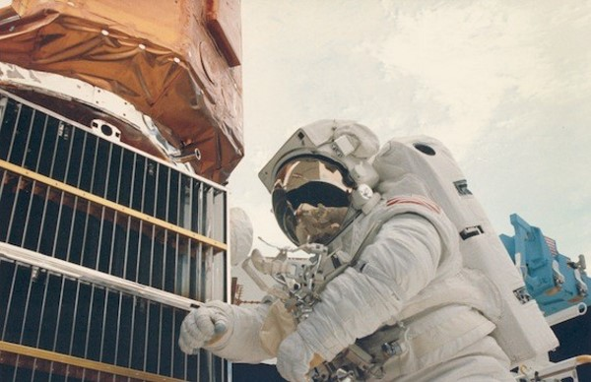
Some possible solutions
Thermal Coating | Emissivity | Mass | Notes
Insulation | 0.05 | 0.3$\frac{kg}{m^{2}}$ | Passive system
Radiators | 0.8 | 0.6$\frac{kg}{m^{2}}$ | Passive system
White paint* | 0.85 | Negligible | Passive system
Black paint** | 0.874
Radiators w/louvers | 0.05 – 0.8 | 2.1$\frac{kg}{m^{2}}$ | Active system*
* Absorptivity of 0.252
** Absorptivity of 0.975
Each location requires the use of a controller with a mass of .2 kg and power requirement of 2 W
Indicate range of emissivity used in your design
Notes:
Solar Max satellite repair. Several metal louvers and thermal blankets were returned from the Solar Max satellite. Returned surfaces are a source of information on sub-millimeter sized orbital debris Credit: NASA, Orbital Debris Program Office

Slide 43
Mass and Power Estimates
Thermal Component | Mass | Power | Comments
Multi-layer insulation | 0.73 kg/m² | 0 | Based on 15 layers
Miscellaneous: Heaters (kapton) Thermostats Thermistors | .025kg/W | As needed | Thermal input based on power requirements
Heat pipes (NH₃) | 0.15 kg/m | 10 W for VCHP* | Mass per unit length Add 1-3 kg each for VCHP reservoirs Control power for VCHPs only
Active refrigeration | 2 – 5 kg | 10 – 30 W | Control power
Radiator panels | 3.3 kg/m² | 0 | Honeycomb radiator Add heat pipe mass if embedded
Electronic controllers | 0.2 kg | 1 – 3 W | Each
* Variable Conductance Heat Pipe
SMAD, Table 11.49
Typically, thermal control hardware mass ranges from 2% to 10% of spacecraft dry mass. For purely passive control, mass tends toward the lower end of the range. When active control is used, mass tends toward the higher end of the range.
Notes:
With Sun
Without Sun

Slide 44
EXAMPLE
Last time, you determined the equilibrium temperatures (in the eclipse and in the sun) for a 1m³ cube isothermal spacecraft.
You have been given a budget of $400K to design a thermal control system for the spacecraft You have the following choices. Assume each kg of mass added adds $25,000 to the cost of the mission.
*
Thermal Coating | Emissivity | Mass | Notes
Insulation | 0.05 | 0.3 kg/m² | Passive system
White paint* | 0.85 | Negligible | Passive system
Black paint** | 0.874 | Negligible | Passive system
Radiators | 0.8 | 0.6 kg/m² | Passive system
Radiations w/louvers° | 0.05 – 0.8 | 2.1 kg/m² | Active system
HHeaters^{Δ} | ---------------------- | 0.025 kg/m² | Active system
* Absorptivity of 0.252
**Absorptivity of 0.975
° Each location requires the use of a controller with a mass of .2 kg and power requirement of 2 W. Also indicate range of emissivity used in your design
^{Δ} Thermal input based on power requirements
Notes:
Solar Max satellite repair. Several metal louvers and thermal blankets were returned from the Solar Max satellite. Returned surfaces are a source of information on sub-millimeter sized orbital debris Credit: NASA, Orbital Debris Program Office

Slide 45
EXAMPLE
Last time, you determined the equilibrium temperatures (in the eclipse and in the sun) for a 1m³ cube isothermal spacecraft.
You have been given a budget of $400K to design a thermal control system for the spacecraft You have the following choices. Assume each kg of mass added adds $25,000 to the cost of the mission.
*Absorptivity of 0.252
Thermal Coating | Emissivity | Mass | Notes
Insulation | 0.05 | 0.3 kg/m² | Passive system
White paint* | 0.85 | Negligible | Passive system
Black paint** | 0.874 | Negligible | Passive system
Radiators | 0.8 | 0.6 kg/m² | Passive system
Radiations w/louvers° | 0.05 – 0.8 | 2.1 kg/m² | Active system
Heaters^{Δ} | ---------------------- | 0.025 kg/m² | Active system
* Absorptivity of 0.252
**Absorptivity of 0.975
° Each location requires the use of a controller with a mass of .2 kg and power requirement of 2 W. Also indicate range of emissivity used in your design
^{Δ} Thermal input based on power requirements
Notes:
Solar Max satellite repair. Several metal louvers and thermal blankets were returned from the Solar Max satellite. Returned surfaces are a source of information on sub-millimeter sized orbital debris Credit: NASA, Orbital Debris Program Office

Slide 46
EXAMPLE
Last time, you determined the equilibrium temperatures (in the eclipse and in the sun) for a 1m³ cube isothermal spacecraft.
You have been given a budget of $400K to design a thermal control system for the spacecraft You have the following choices. Assume each kg of mass added adds $25,000 to the cost of the mission.
*Absorptivity of 0.252
Thermal Coating | Emissivity | Mass | Notes
Insulation | 0.05 | 0.3 kg/m² | Passive system
White paint* | 0.85 | Negligible | Passive system
Black paint** | 0.874 | Negligible | Passive system
Radiators | 0.8 | 0.6 kg/m² | Passive system
Radiations w/louvers° | 0.05 – 0.8 | 2.1 kg/m² | Active system
Heaters^{Δ} | ---------------------- | 0.025 kg/m² | Active system
* Absorptivity of 0.252
**Absorptivity of 0.975
° Each location requires the use of a controller with a mass of .2 kg and power requirement of 2 W. Also indicate range of emissivity used in your design
^{Δ} Thermal input based on power requirements
Notes:
Solar Max satellite repair. Several metal louvers and thermal blankets were returned from the Solar Max satellite. Returned surfaces are a source of information on sub-millimeter sized orbital debris Credit: NASA, Orbital Debris Program Office

Slide 47
EXAMPLE
Last time, you determined the equilibrium temperatures (in the eclipse and in the sun) for a 1m³ cube isothermal spacecraft.
You have been given a budget of $400K to design a thermal control system for the spacecraft You have the following choices. Assume each kg of mass added adds $25,000 to the cost of the mission.
*Absorptivity of 0.252
Thermal Coating | Emissivity | Mass | Notes
Insulation | 0.05 | 0.3 kg/m² | Passive system
White paint* | 0.85 | Negligible | Passive system
Black paint** | 0.874 | Negligible | Passive system
Radiators | 0.8 | 0.6 kg/m² | Passive system
Radiations w/louvers° | 0.05 – 0.8 | 2.1 kg/m² | Active system
Heaters^{Δ} | ---------------------- | 0.025 kg/m² | Active system
* Absorptivity of 0.252
**Absorptivity of 0.975
° Each location requires the use of a controller with a mass of .2 kg and power requirement of 2 W. Also indicate range of emissivity used in your design
^{Δ} Thermal input based on power requirements
Notes:
Solar Max satellite repair. Several metal louvers and thermal blankets were returned from the Solar Max satellite. Returned surfaces are a source of information on sub-millimeter sized orbital debris Credit: NASA, Orbital Debris Program Office

Slide 48
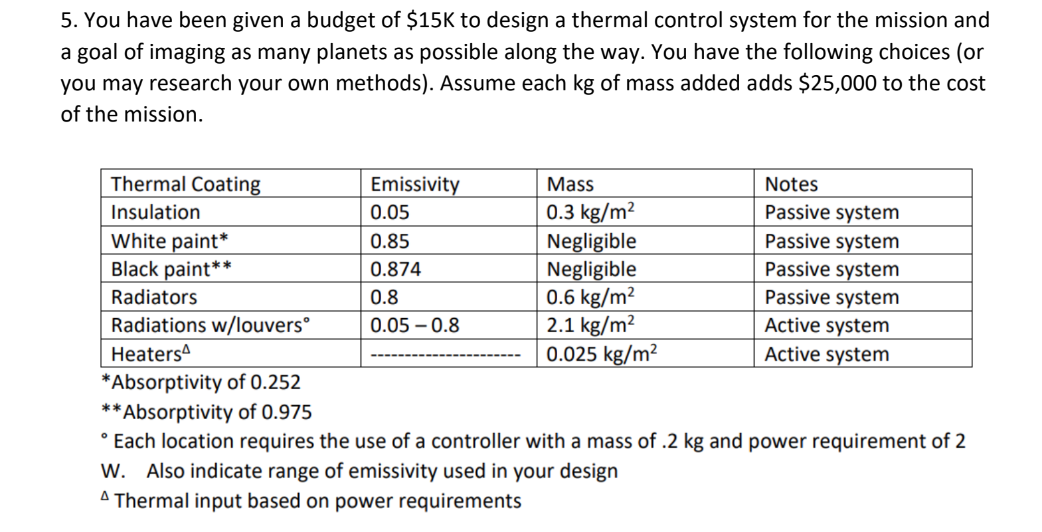
HOMEWORK PROBLEM 5

Slide 49
REFERENCES
CALCULLA (n.d.). Table of Chemical Bond Energies. https://calculla.com/bond_energy
Gilmore, David G. (2002). Spacecraft Thermal Control Handbook, Volume 1.
Jenner, L. (2015, May 5). Webb Telescope Test: Insulating from Heat and Cold. NASA. https://www.nasa.gov/content/goddard/webb-telescope-test-insulating-from-heat-and-cold/.
Larson, W. J., & Wertz, J. R. (2005). Space mission analysis and design. Kluwer Academic Publishers.
Merstallinger, A., & Sales, M. (2010). COLD WELDING DUE TO IMPACT AND FRETTING UNDER VACUUM.: CONSIDERING SCALING FOR APPLICATIONS IN SPACE MECHANISMS. Mechanical Properties of Complex Intermetallics, 191–248. https://doi.org/10.1142/9789814322171_0006
NASA. (July 24, 2014). Atomic oxygen effects - NASA technical reports server (NTRS). NASA. https://ntrs.nasa.gov/citations/20150000130
PEDIAA. (2017, January 4). Difference between single double and triple bonds: Definition, formation, properties, examples. Pediaa.Com. https://pediaa.com/difference-between-single-double-and-triple-bonds/

